Slide 1
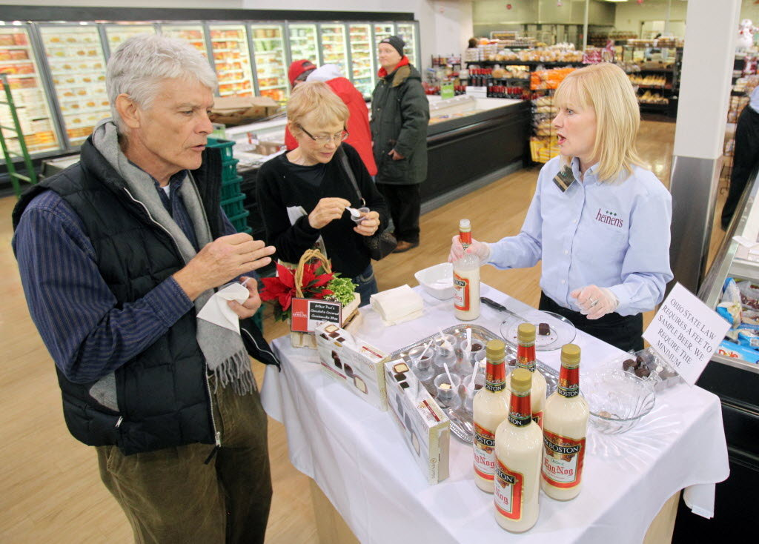
Sampling
Geog4300/6300
Jerry Shannon

Slide 2
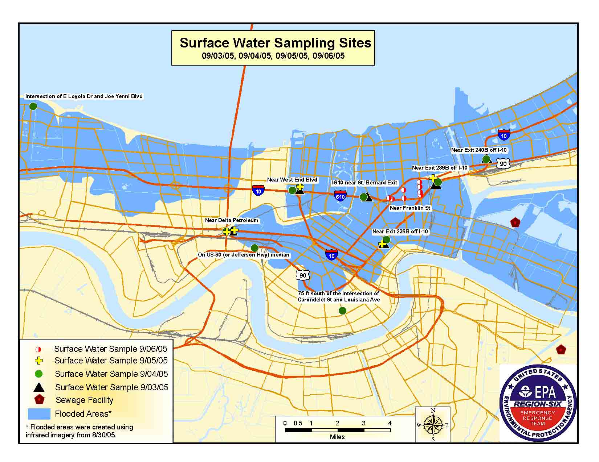
Why sample?
Saves money
Saves time
Full sample may be impossible/impractical

Slide 3

Sample research question:
Do veterans find it easy to use their GI Bill educational benefits at state colleges and universities?

Slide 4
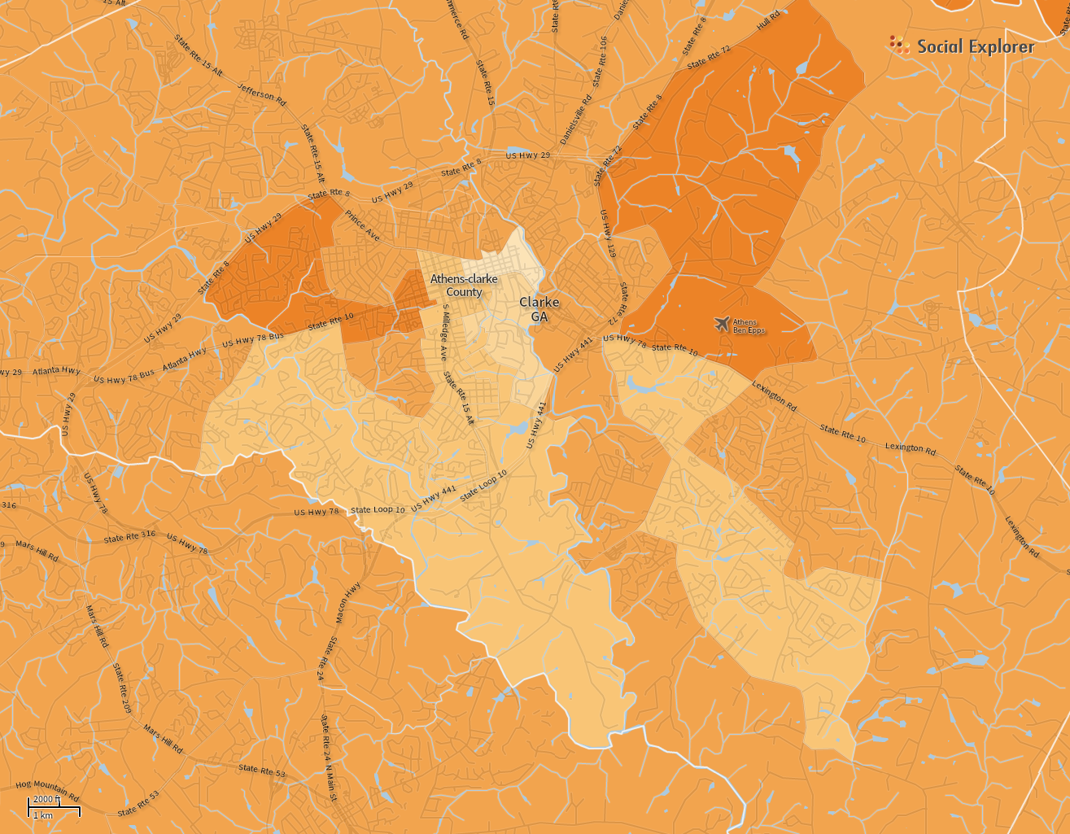
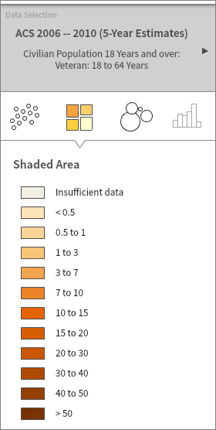
Some terminology
Target population and target area
(“Population” can mean many things…)
Veterans in Clarke County

Slide 5
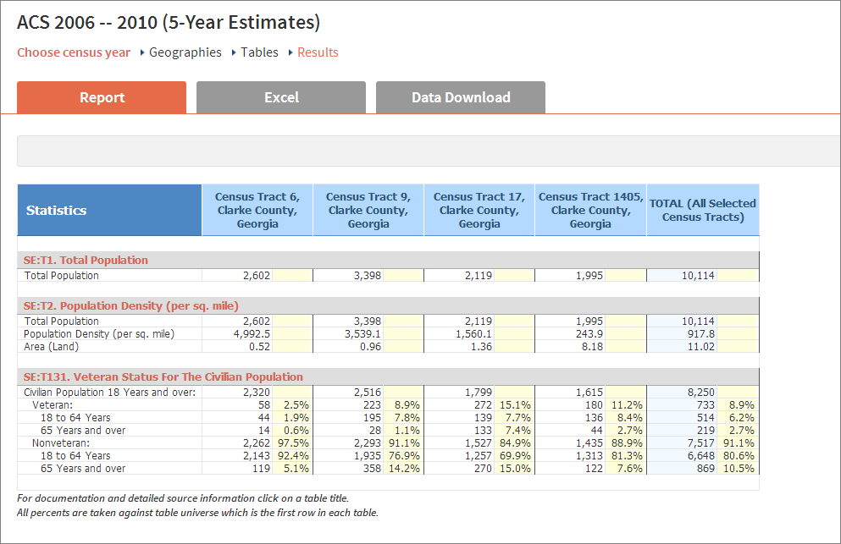
Some terminology
Sampling frame—population and area

Slide 6
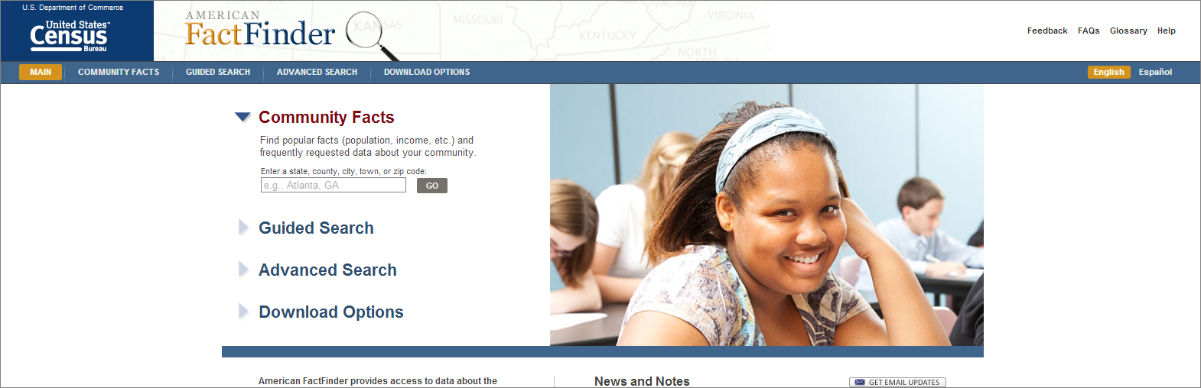
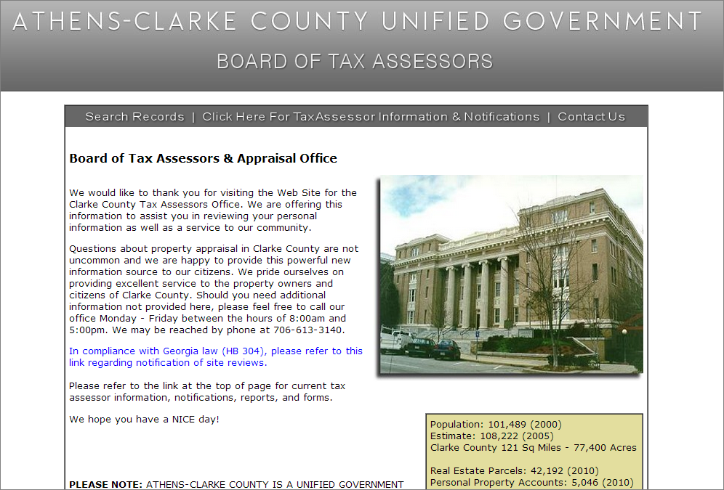
Sources of sampling frame data?

Slide 7
Non-probability sample Convenience
Snowball
Quota
Probability sample
Random
Systematic
Stratified
Cluster
Do some research!
Give a one minute summary of what this sampling strategy entails
How would it be used with our study of Clarke County veterans?
What’s one advantage and/or pitfall you see with this approach?

Slide 8
Finding sample size: Error of the mean
What is the mean number of job applications sent out by soon to be Geography graduates? You did a survey of 50 such students. The mean was 8.34 and the s.d. was 4.8.
How many students should you ask if you want your mean to be accurate to within 1 application, with 95% confidence?

Slide 9
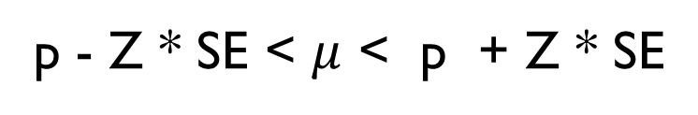
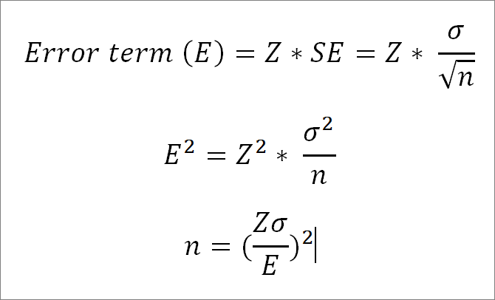
Finding sample size: Error of the mean

Slide 10
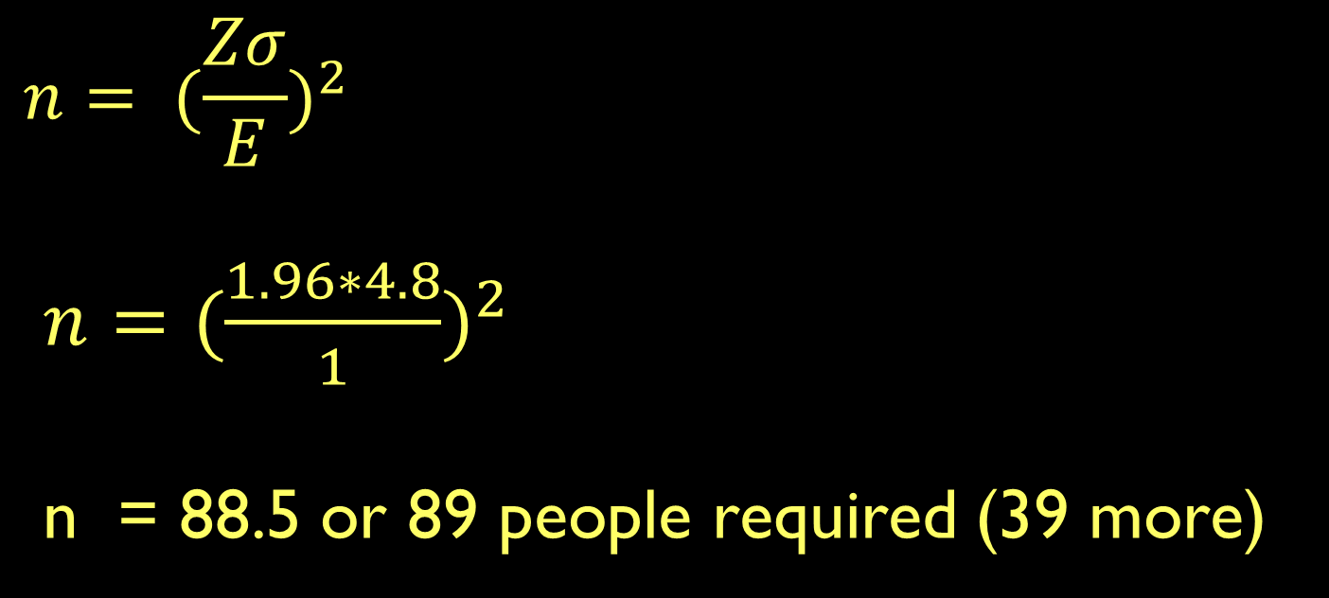
Finding sample size: Error of the mean

Slide 11
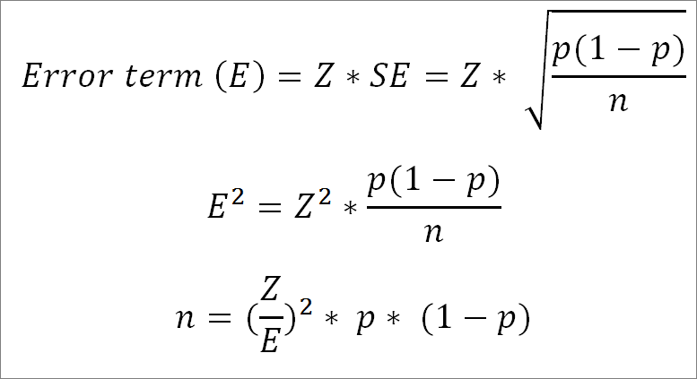
Finding sample size: Error of proportion

Slide 12
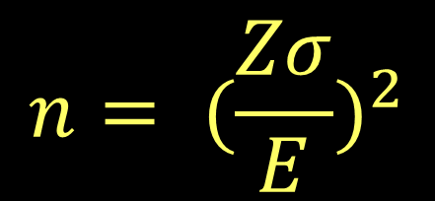
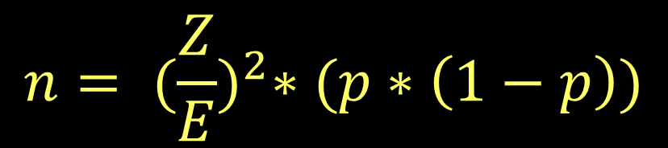
Finding sample size: Error of proportion
What if you wanted to know the proportion of grads sending out 15 or more applications? Your initial survey suggests that 8.3% currently do so. How many more students would you need to have a margin of error less than 2% (with 95% confidence)?

Slide 13
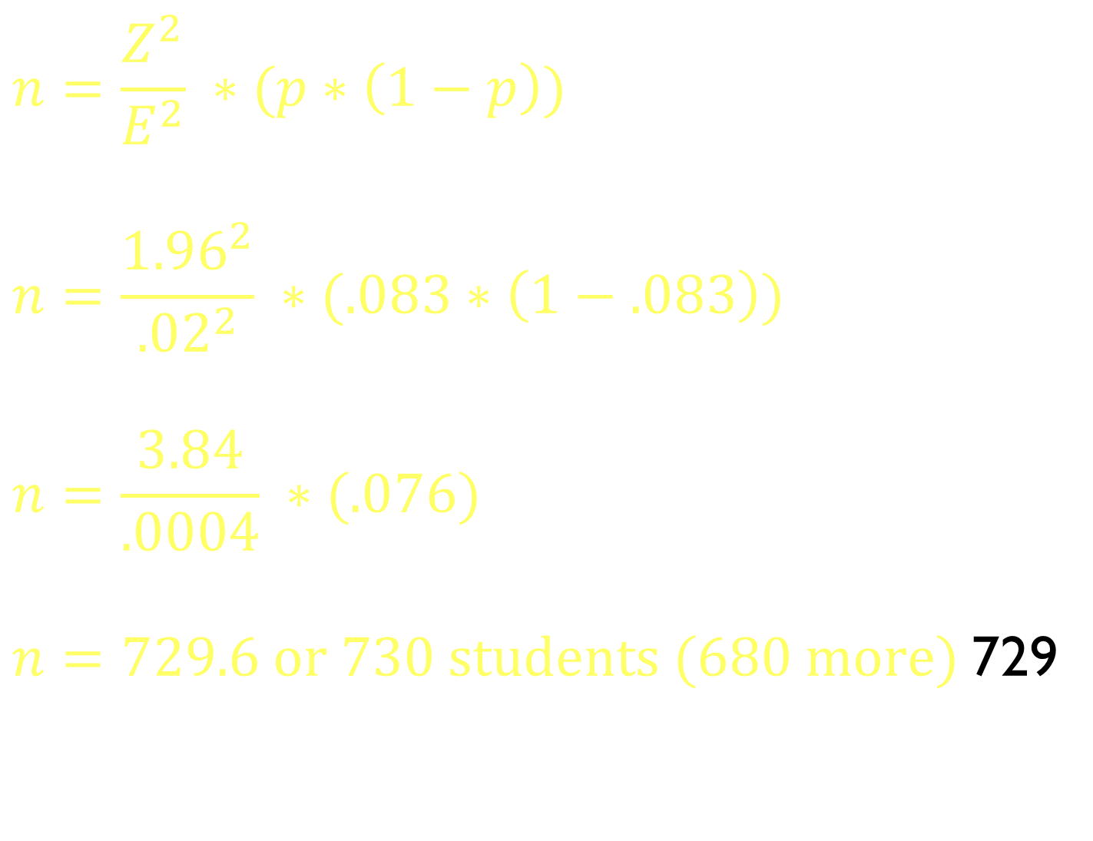
Finding sample size: Error of proportion

Slide 14
Finding sample size: Error of proportion
What if we don’t have initial data?
A proportion of 0.5 produces the most conservative sample size estimate

Slide 15

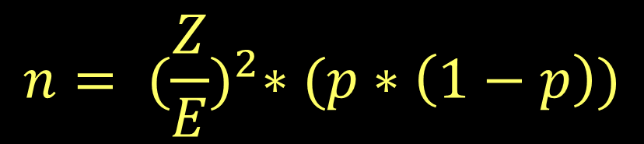
Practice
1. A study is seeking to find the number of televisions owned by graduate students. The national standard deviation is 1.2. Assuming the same variance, how many graduate students would need to be surveyed to have a 95% estimate with an accuracy of 0.5 televisions?
2. A survey estimated that 20% of all Canadians aged 16
to 20 drove under the influence of drugs or alcohol in the last year. A similar survey is planned for the US. They want a 95% confidence interval with a margin of error of 0.02 (2%). How large should the sample be?
Notes:
Q 1: 29.6 stores
Q 2: 1,536.6 people

